Slide 1
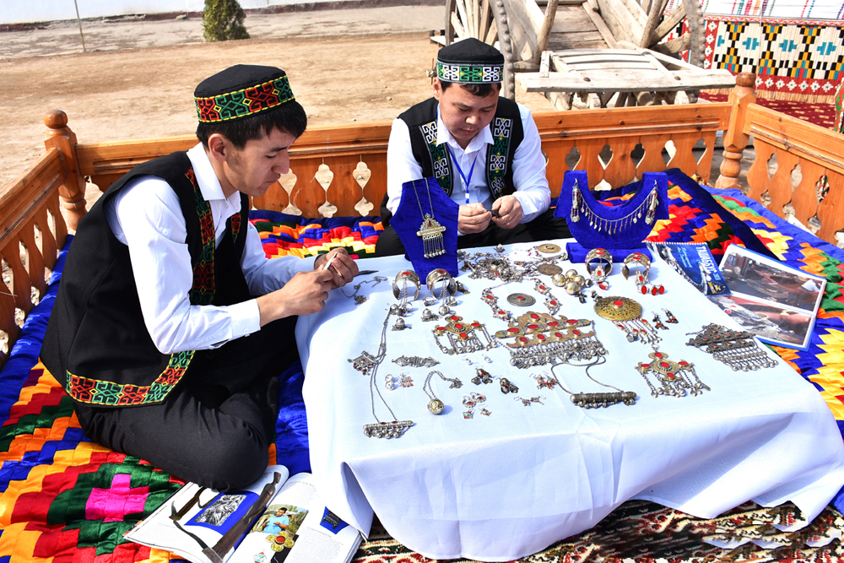


Full itinerary and detailed information about the trip
An educational tour to the craftsman of Chimbay
BEST CHOICE
BEST PRICES
RELIABLE TEAM

Slide 2

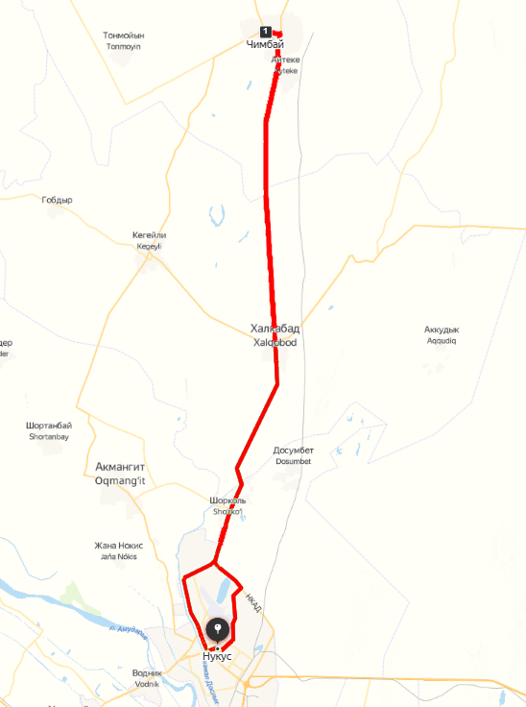

Trip itinerary
Duration:
1 - Day
Tour season:
Year-round
Total distance:
More than 120 km
Meals:
on request
Transport:
Sedan / Minibus

Slide 3

Day 1: Nukus – Chimbay – Nukus
Start point:
Nukus city (Railway Station, Airport, Hotel, etc.)
Chimbay has been one of the largest shopping centers since the Middle Ages, where craft workshops were concentrated, each of which is like a separate page of great history. To date, modern artisans of Chimbay\y are reviving the forgotten crafts of the Karakalpaks. One of the brightest gems of this amazing corner is Topi aul, a real paradise for connoisseurs of authenticity. Here, among the authentic Karakalpak houses with flat roofs, time seems to stop.
Topi aul is located near the waters of the canal, where reeds grow, which is used in handicrafts and is a real ark of traditions.
Here, the residents, being the real keepers of the national heritage, are masterfully engaged in harvesting reeds and creating unique reed mats, known as shi. But what about a master class on bread preparation (shorek and tan nan), a juery gurtuk made of sugar flour and delicious baursaks (fried bread in butter), which will immerse you in the atmosphere of real Karakalpak hospitality.
Next, in Uishi's workshop, you will discover the secrets of creating the Karakalpak yurt. The details for these amazing buildings are still made on antique artisanal machines that pass the craftsmanship from generation to generation. Here, on the same artisanal machine, talented carpet makers create carpet strips, decorating the skeleton of the yurt and creating a unique interior.
09:00 10:00 Meeting with the driver at the specified location and transfer from Nukus to the Chimbay district.
10:00-11:00 Visit to a hospitable family who will reveal to you the secrets of the methods of creating traditional shi'a (reed mats). This master class will be a unique experience in which every tourist will want to participate in the creative process.
11:00-13:00 Master class of Karakalpak traditional dishes: in an authentic manner. Every tourist can participate in the preparation of baursaks (doughnuts from pastry), a hot dish of Zhugyry kurduk (tk flour Sogo) embodying cultural values.
13:00-14:00 - Lunch in an authentic setting, where each dish carries the legacy of history.
14:00-14:40 – Visit to some authentic villages of Chimbay.
14:40-16:20 – Visit to the workshop of Uishi (a yurt craftsman). You will get acquainted with the details that embody traditions from a long time ago, and you can even try your hand at creating something unique.
16:25-17:25 – Visit to the artisans, who turn every carpet from a distance into a work of art. These are the stripes for the decorations of yurts, which reflect the national flavor of the Karakalpak heritage.
17:15-18:00 - At the end of an exciting day full of creativity and discoveries, you will return to Nukus, but a piece of warmth and harmony of this unique cultural journey will forever remain in your hearts.

Slide 4
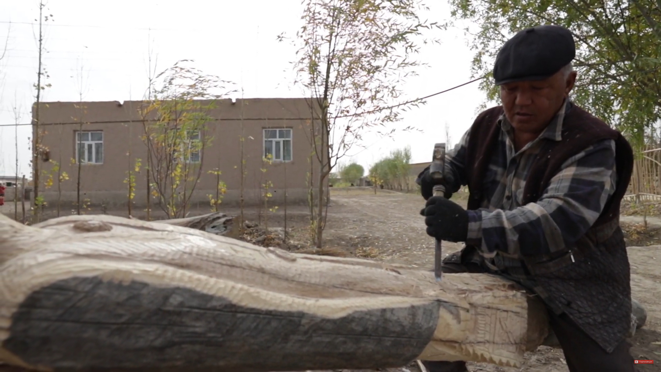
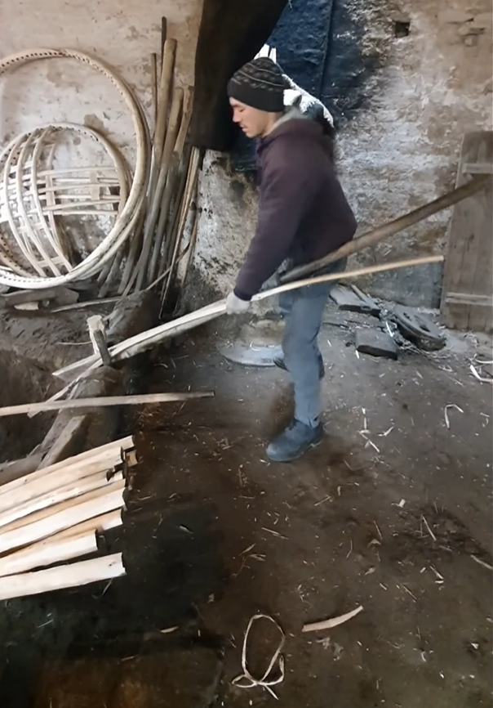
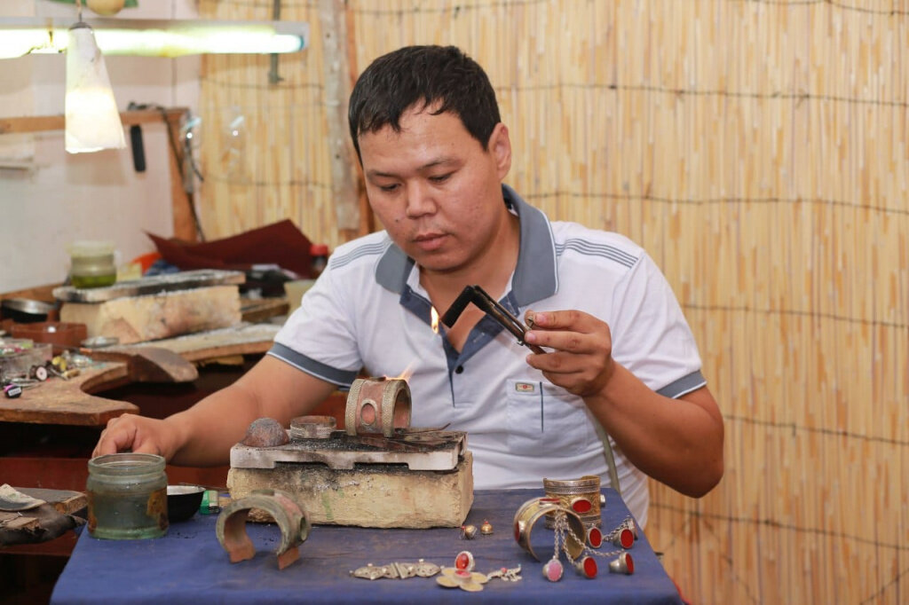
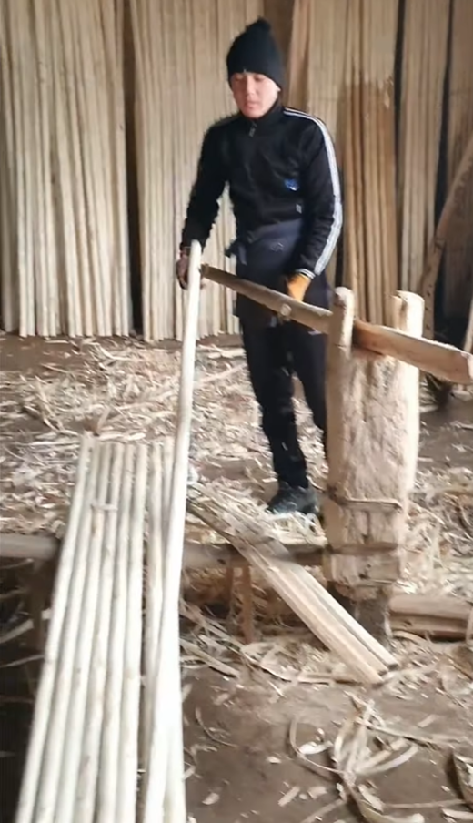
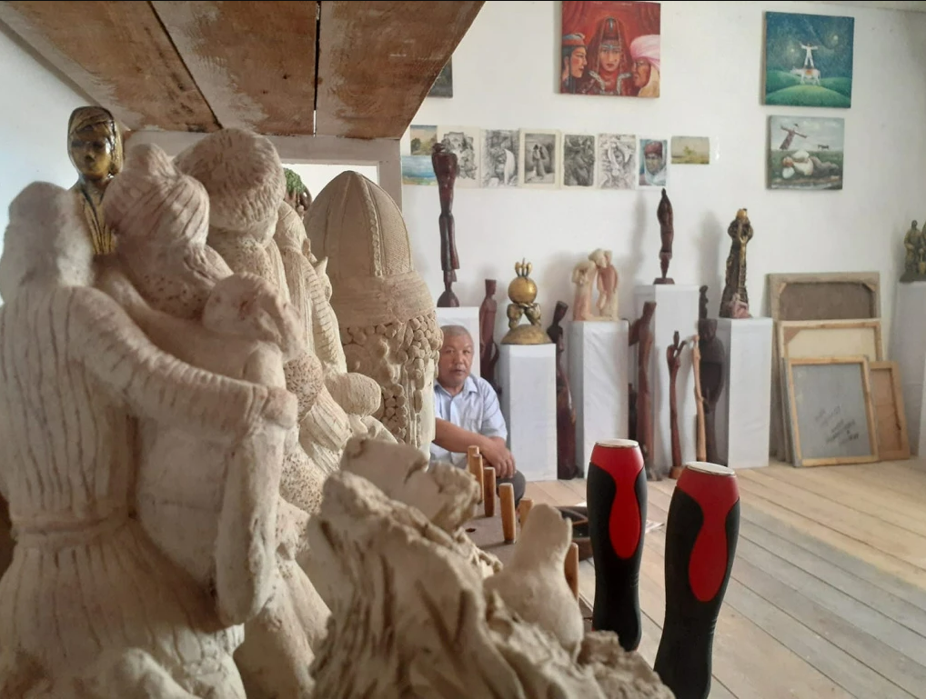
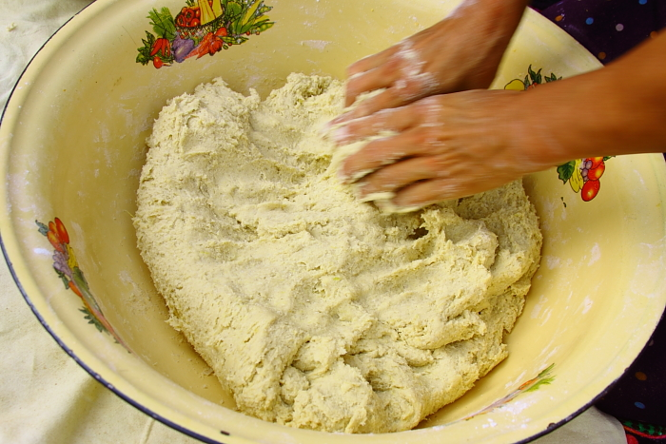

Slide 5
